Slide 1

Activities of the
German Arab Chamber

Slide 2

Our Aim is to Share Experiences
North –South,South North & South-South in:
Advocacy
Novel Services
Projects
Support startups & SMEs
Simply improve the business climate to promote trade, investment, innovation, and human resources development
GACIC

Slide 3
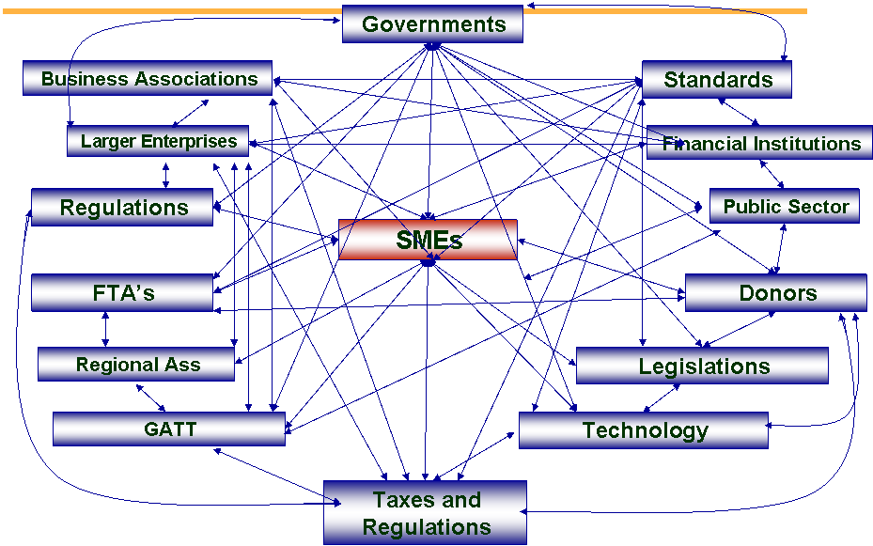

And help SMEs navigate the Maze
GACIC

Slide 4



Like Access to Finance
The €550 Billion
Initiative
The Euro-Mediterranean
Conference & Exhibition on
Donor Funding, Banking and
Novel Financial Instruments
M E D A F I N A N C E

Slide 5


An Annual Initiative
To Bridge Businesses with Finance

Slide 6


Slide 7
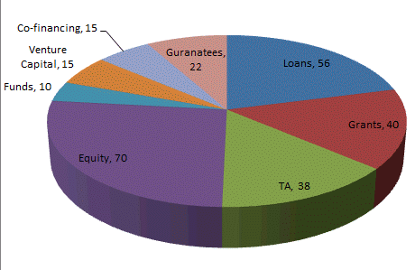
Over € 554 billion
Loans | Grants | TA | Equity | Funds | Venture Capital | Co-financing | Guarantees
56 | 40 | 38 | 70 | 10 | 15 | 15 | 22

Slide 8


















For BSOs also like we do

Slide 9
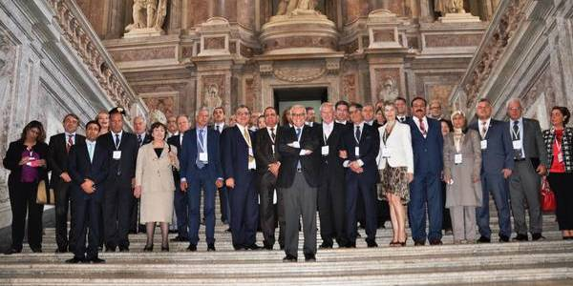
Mobilizing Political Support
The Mediterranean Parliamentary Assembly

Slide 10

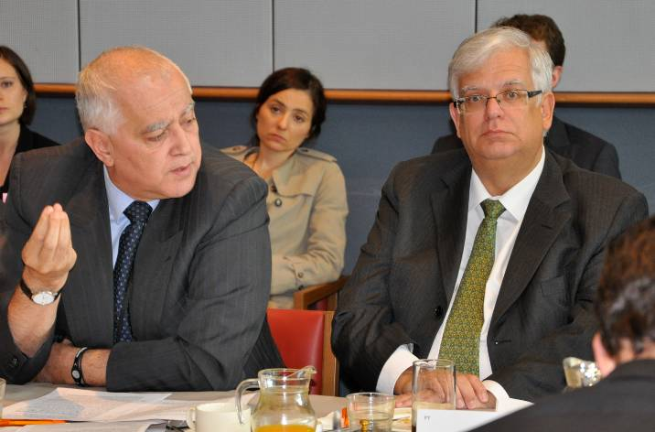
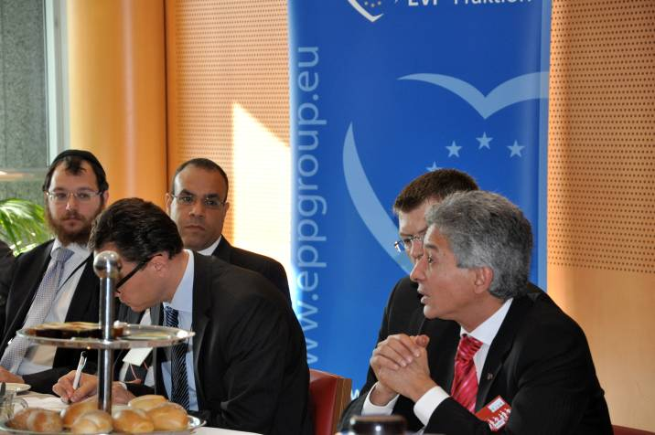
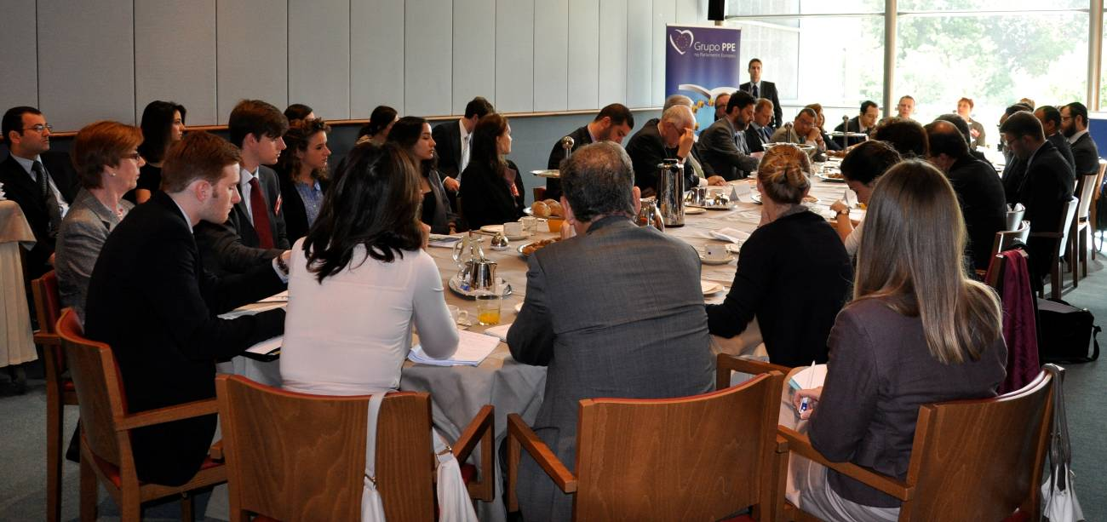
And the European Parliament

Slide 11
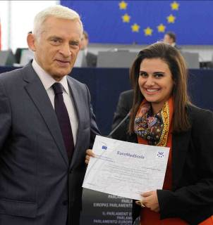
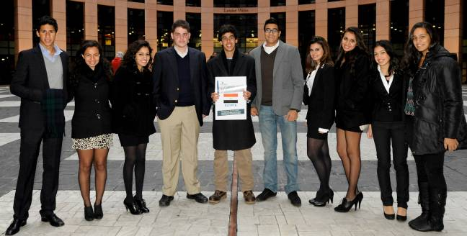
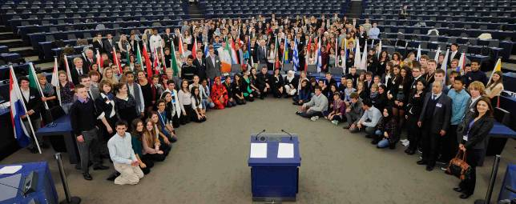
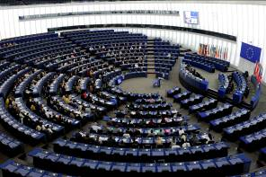
Mobilizing Youth

Slide 12
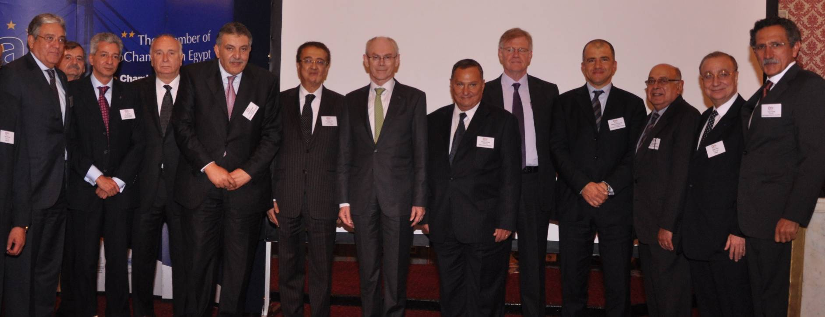
Bring together ALL partners
EU President von Rompuy with EuroMed Presidents of Regional federations , MoFA, Moic and EU ambassador Launching the business implemented ENPI CBC 8 projects

Slide 13
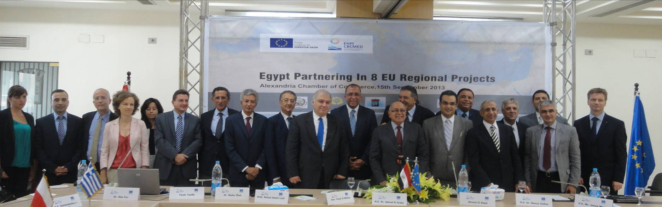
In a Public Private Regional Partnership
Ministers, EU member State’s Ambassadors and Consul’s General, and presidents of Federations , MoFA, Moic kicking off the business implemented ENPI CBC 8 projects

Slide 14

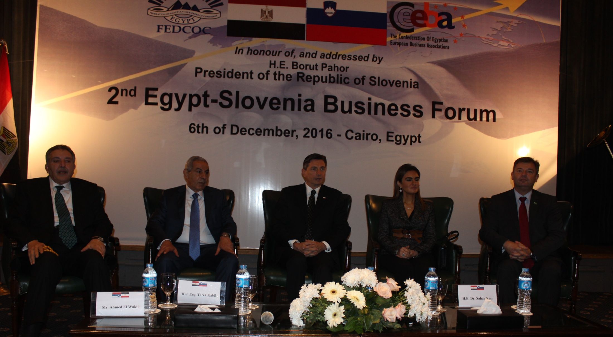
Supported by Head’s of State

Slide 15
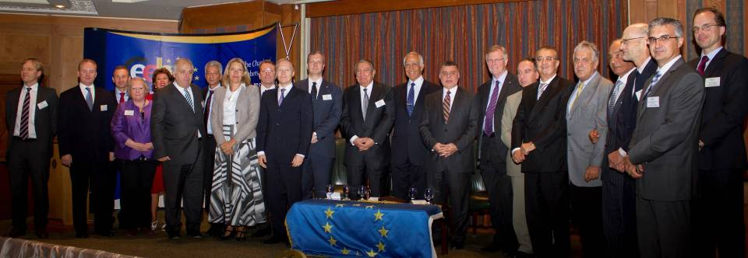
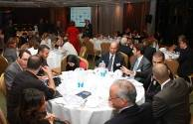
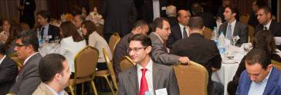
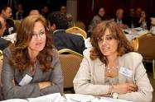
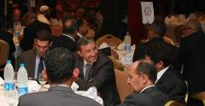
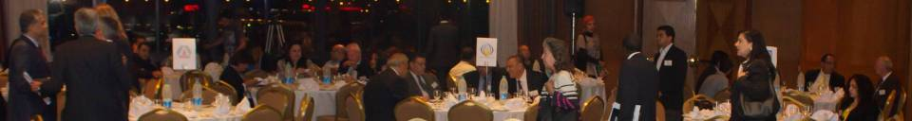
And with all EU Member State’s

Slide 16
Through
“Creating Clusters” in and across its borders
“Conducting Studies” on the specific sectors
“Implementing Trainings” for companies and local authorities
“Promoting Technology and Experience Exchange: between partner countries
“Implementing Pilot Projects”
“Creating Awareness” to target audience
“Enhancing Linkages” with relevant projects and sources of finance
“Replicating and sustaining” the gained experience

Slide 17
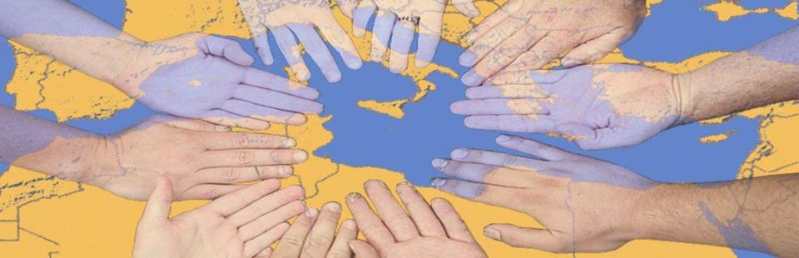


Slide 18
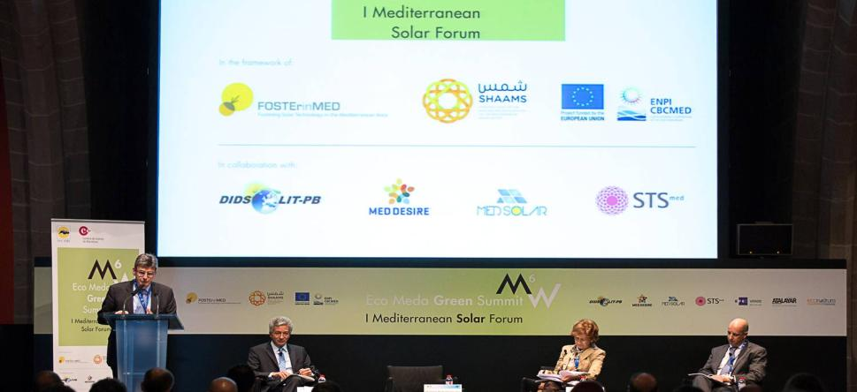

Slide 19
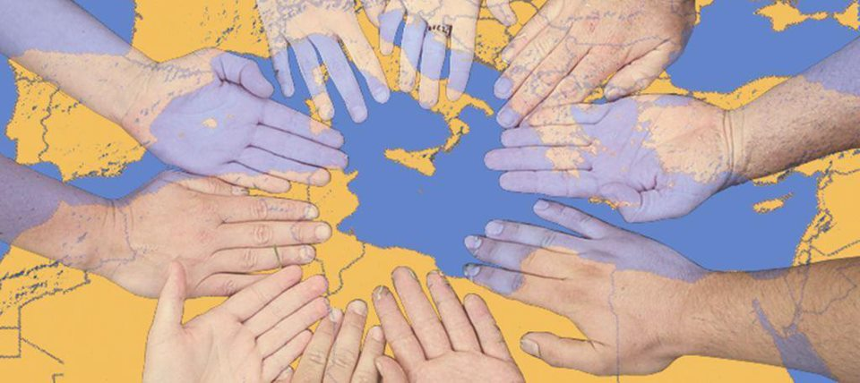
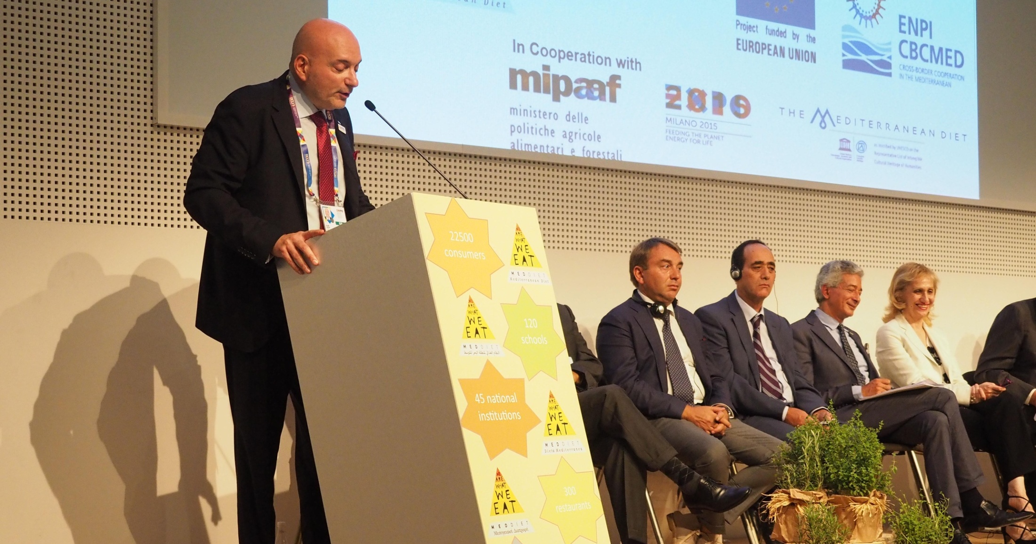

Slide 20
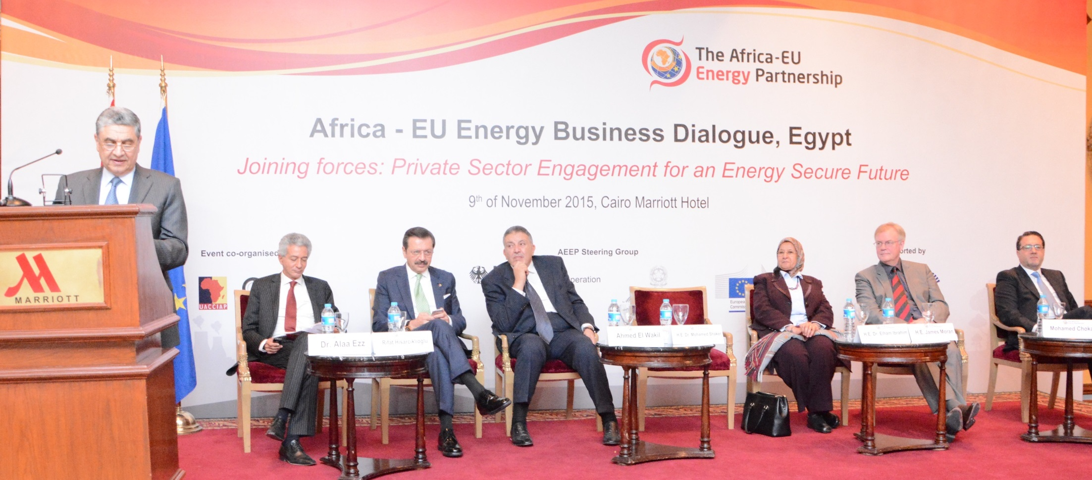

Slide 21
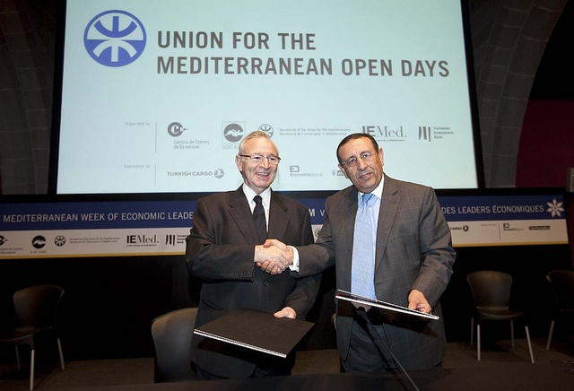


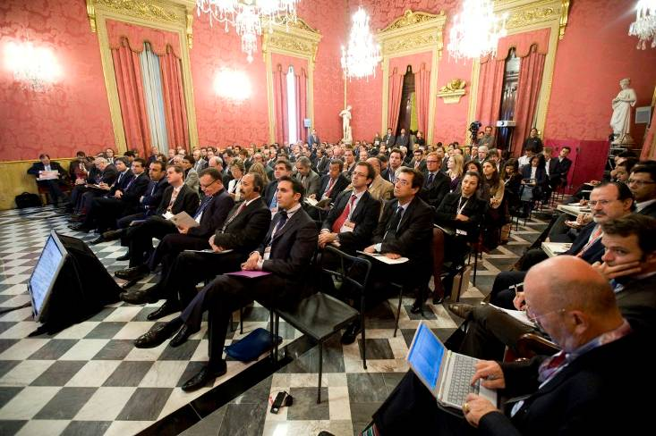

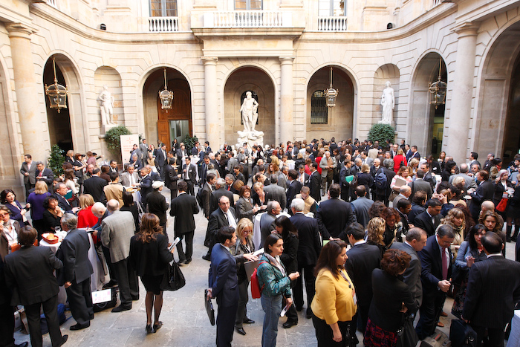


Bringing SMEs Together

Slide 22

In a Public Private Regional Partnership
Ministers, EU member State’s Ambassadors and Consul’s General, and presidents of Federations , MoFA, Moic kicking off the business implemented ENPI CBC 8 projects

Slide 23
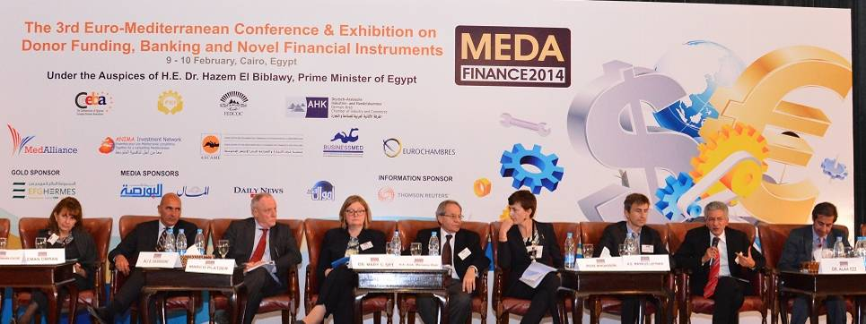
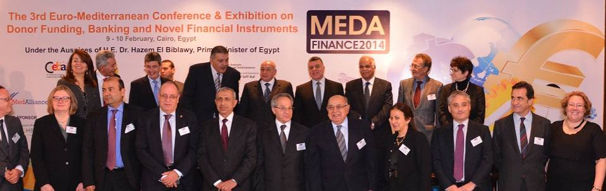
Capitalizing with donors and IFIs

Slide 24
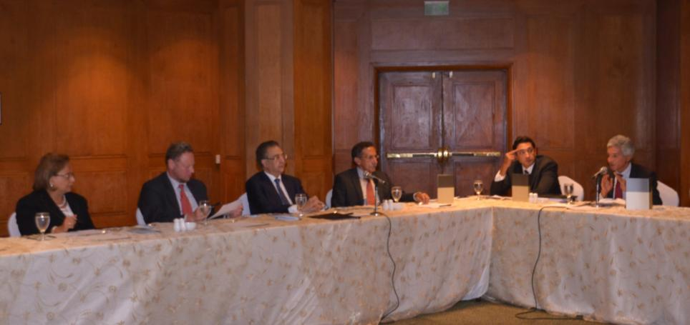
Supporting Cooperation
Minister’s of International Cooperation, Trade and Industry, Supply and Internal Trade, EuropeAid Director Kuller, EU ambassador Moran and chairmen of Business Federations discussing cooperation

Slide 25
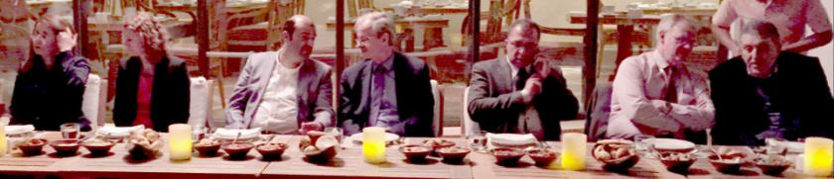
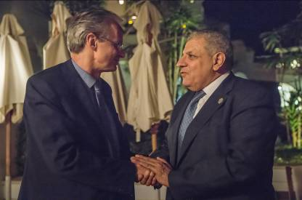
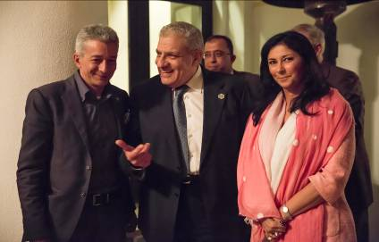
All the time
Prime Minister Mahlab, DG NEAR Director General Danielson, Ministers of Planning, Reform, Supply and Trade, Solidarity, Youth, EU ambassador Moran and chairmen of Business Federations during Sharm El Sheikh Summit

Slide 26
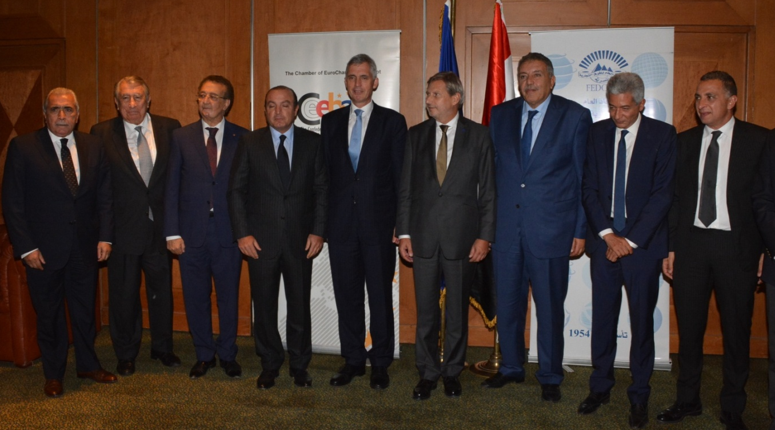
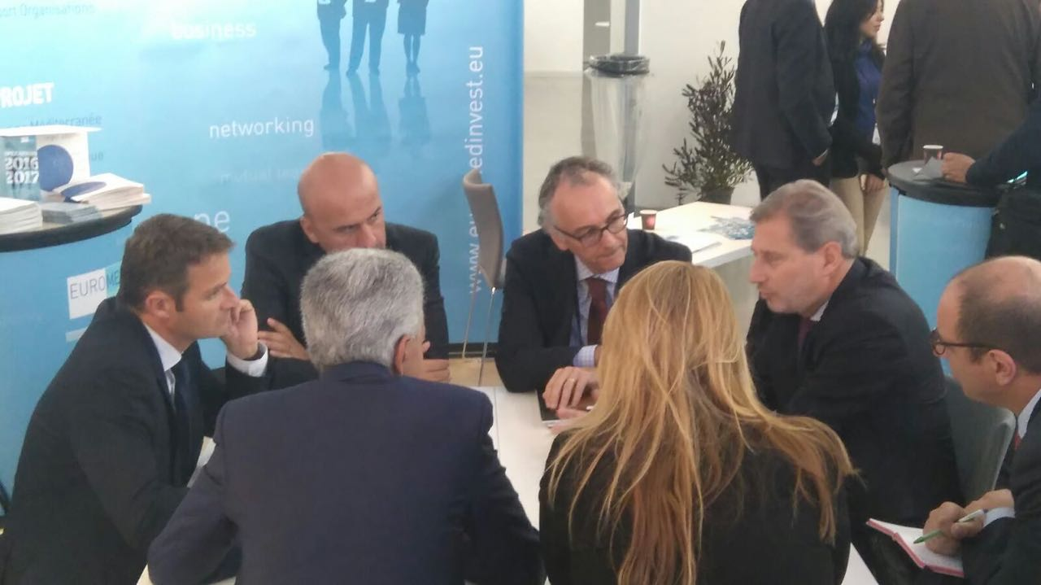
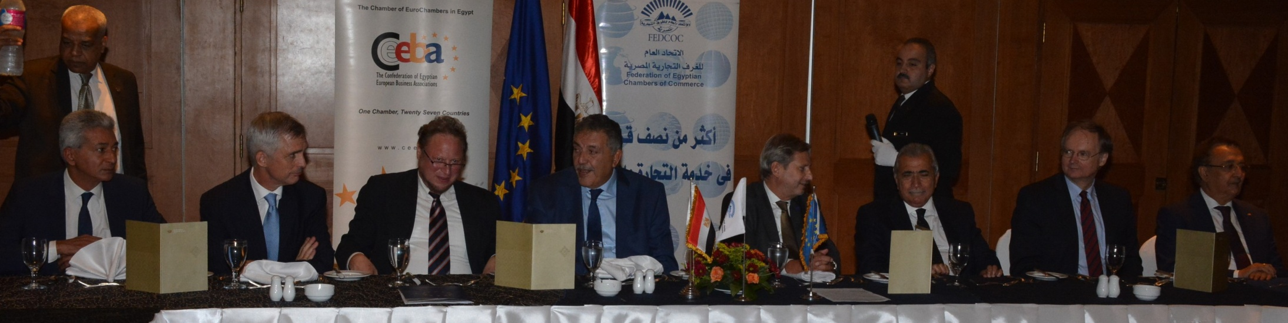
Everywhere

Slide 27
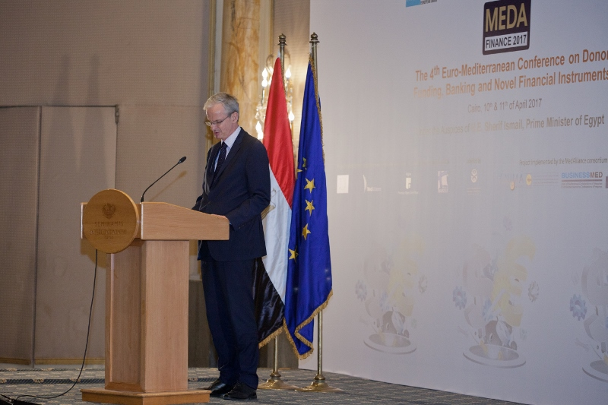
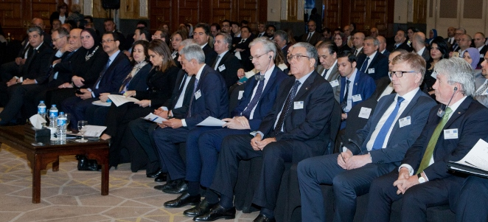
All the Time

Slide 28
Our Aim is simply to
walk the talk
and make every effort to utilize the available means, networks, and cooperation channels; to support
BSOs
Through
EBSOMED
GACIC

Slide 29

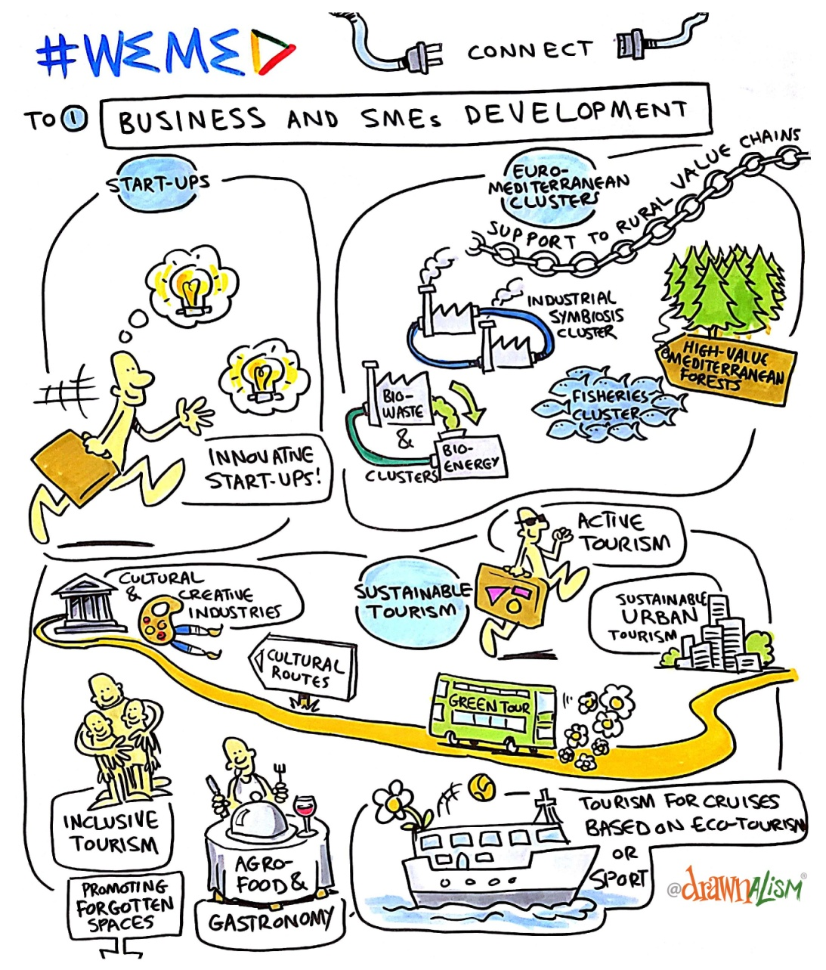
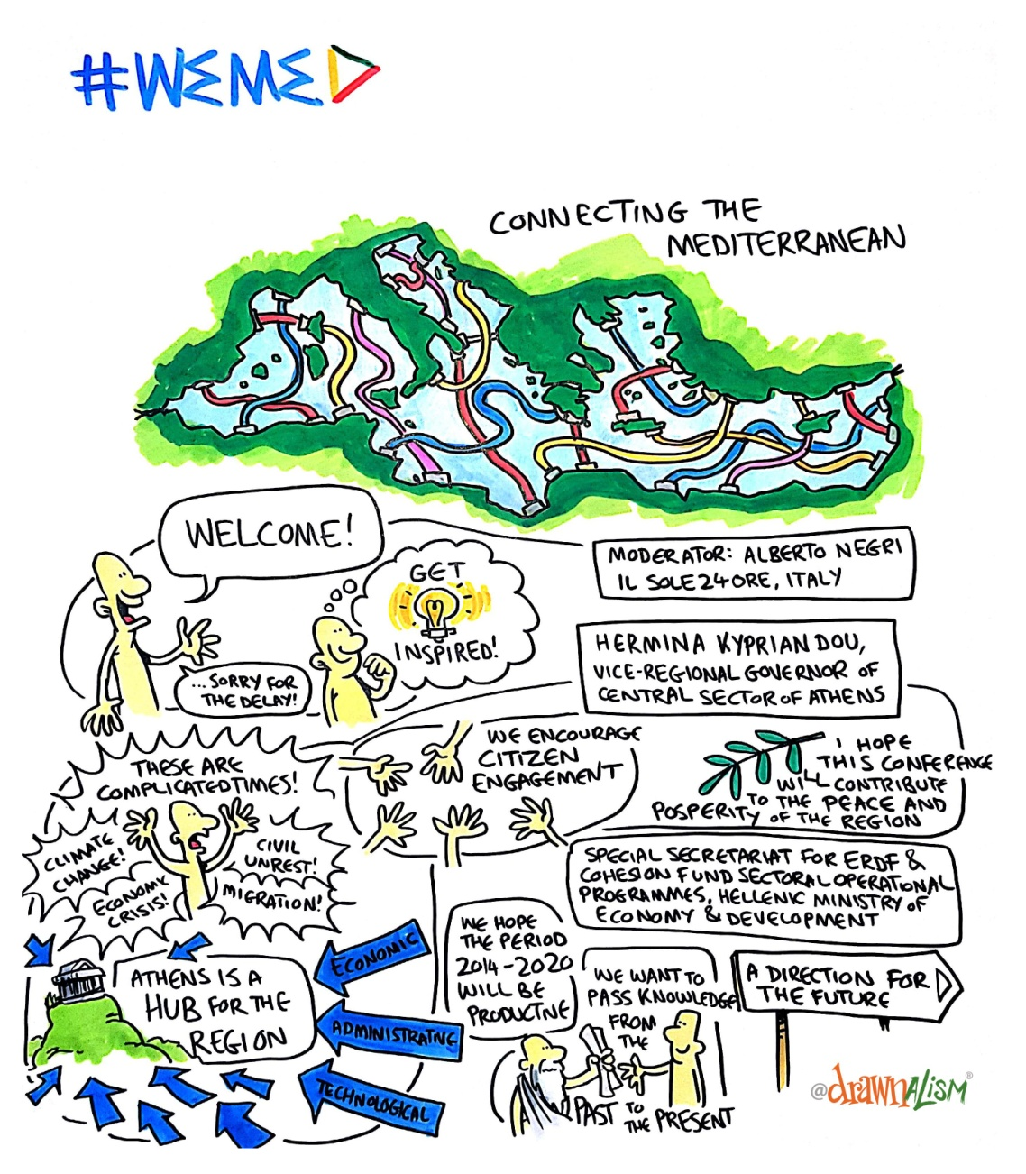

Slide 30
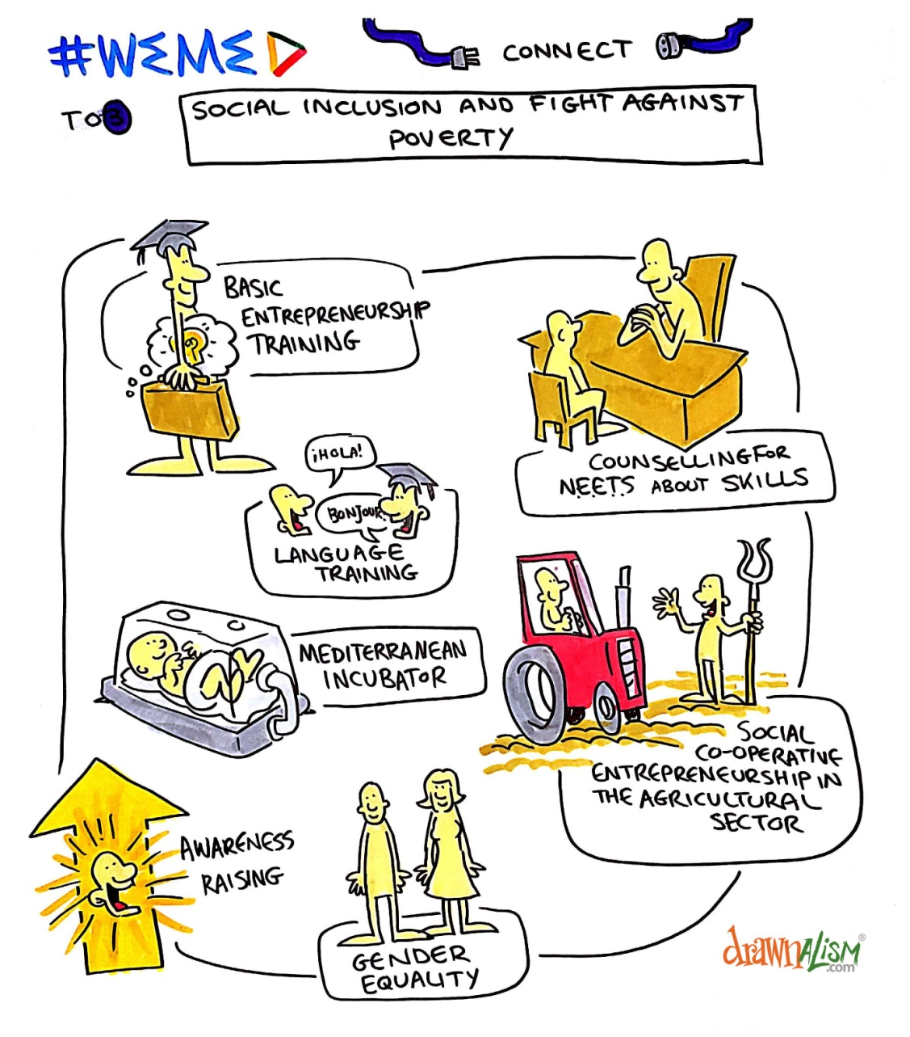
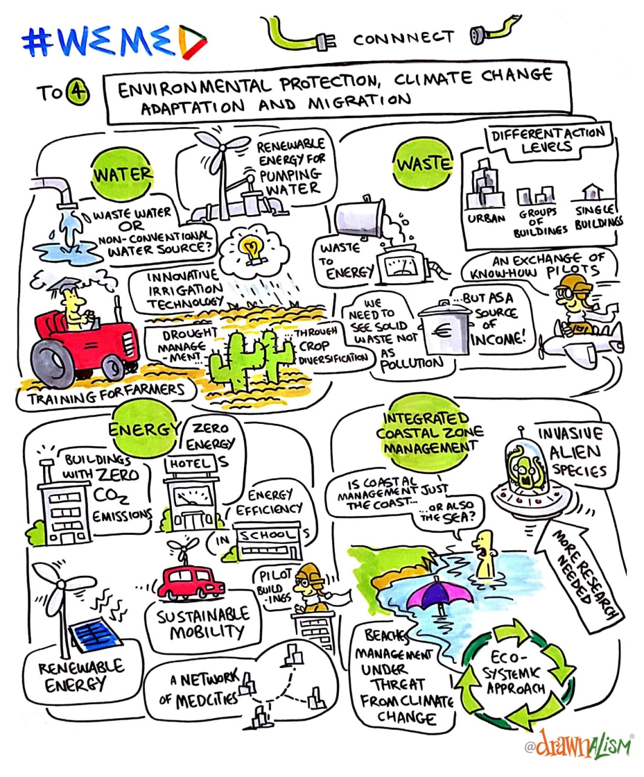

Slide 31
See you all in our next activity

